Slide 1

Leading OEM optimizes sales on e-commerce platform
TMT | Asia-Pacific
HIT029
Client context
Approach
Impact
Leading Asian OEM collaborating with e-commerce players on big data
Pain points
The OEM has just launched an online flagship store. It urgently needs to develop a deep understanding of car owners’ shopping behaviors on e-commerce platform so that it could help recommend star products
Keep track of the sales and future trends of both its own products and competition on e-commerce platform. Closely monitor the sales of its competitors
Extract car owner data (by car model) from the OEM
Match car owners with their accounts on the e-commerce platform and conduct analysis
Define consumer profiles (analyze consumer demographics, life cycle, overall shopping behaviors, etc.; segment consumers by behavior and value and profile the most attractive segments)
Understand consumer preferences for products (compare sales of sub-categories, identify emerging star products; identify most popular non-auto products to drive cross-selling)
Optimize after-sales service value and avoid customer attrition (compare the profiles of “loyal customers” vs “lost customers”; define the strategy to increase basket size and shopping frequency of loyal customers by analyzing customer features; Forecast customers at risk of leaving and design incentives to retain them)
Improved the online flagship store’s traffic and conversion rate (30~50%)
Avoided customer attrition
Developed a better understanding of consumer preferences and provided targeted, convenient customer service (car fragrance is given to customers for free in car owner club events)
M&S client expert
Weiya Guan
Client name: X
Team set-up: X
Fees Structure: X
What was unique: X

Slide 2

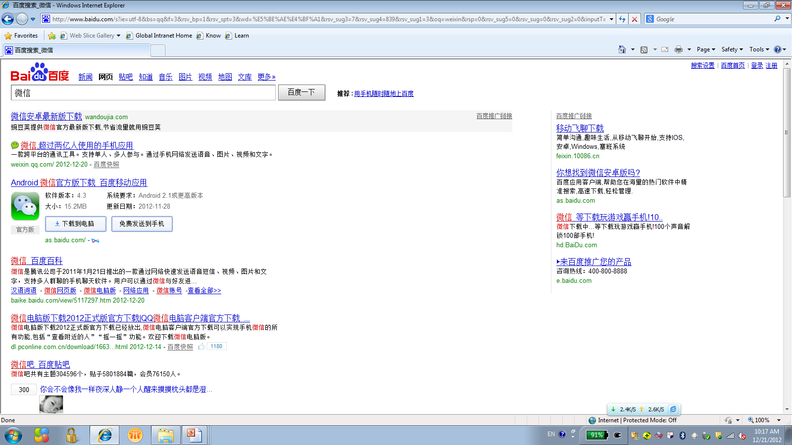
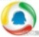
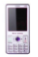
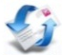
Case: VW China acquired relevant data for customer analysis to engage each potential customer one on one
HQ: R&D, supply chain and marketing strategy management
ERP
Collect & Acquire– HQ and dealers
Screening analysis– HQ
Customer interaction– Dealers
Source of external customer data:
Membership systems of auto vertical websites¹
Purchase data from auto vertical websites
Classify and screen customers
Customer purchasing stage
Customer regional information
Customers’ interest in models
Selection of promotions and timing based on customers’ purchase path
Offer most impactful information to custom-ers at the time and in the way that is most appropriate
Pre-sales: BTL activity offerings
Mid-sales: Focus on USPs to improve sales
Post-sales (initial): Financing, accessories
Post-sales (long-term): Maintenance/ Service
Repurchase: Loyalty plan
Issues: feedback / recall, etc
=
Source of internal customer data:
Customer records from OEM official website
Direct communication such as BBS, instant messengers, etc²
Customer lifestyle (interest, relevance, etc) analysis
Customer flow analysis
+
Dealer real time data:
New buyers
Showroom traffic
Communication method based on target group and medium maturity
Marketing impact and competitor analysis
Evaluate/Monitor/Update
1 Referring to membership systems of auto vertical websites such as BitAuto.com, SOHU auto channel, etc. After dealers register as members, the system will automatically collect information of local users who have visited and followed the dealers, and send that information to OEMs. 2 Specially assigned division from HQ manually collects potential customer information through the direct to consumer communication in BBS, instant messengers like QQ groups, Wechat groups, etc.
SOURCE: Expert interviews

